Slide 1
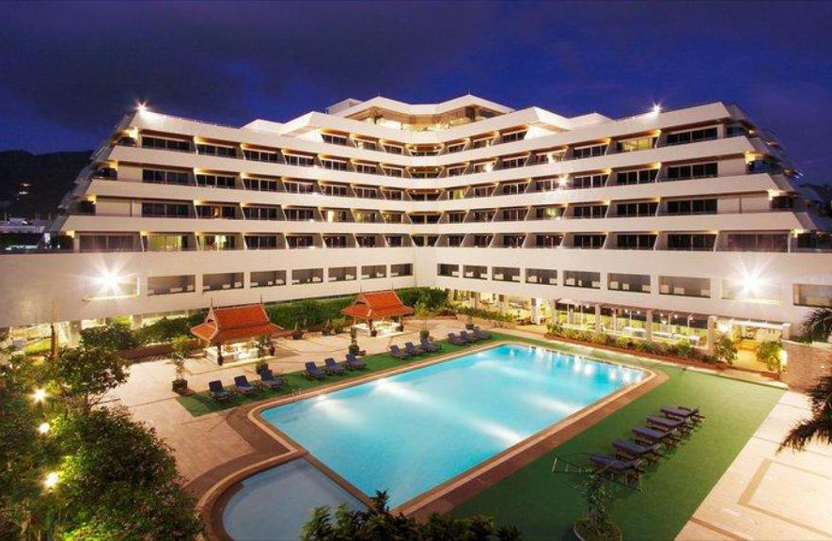
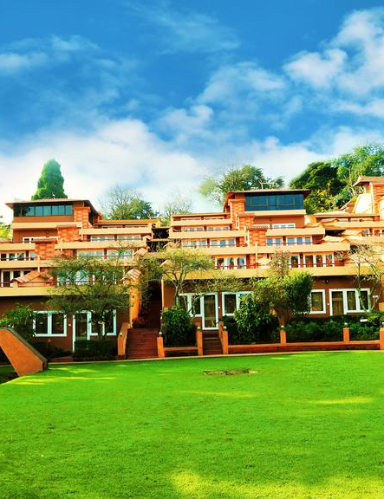

EDA of Hotel Bookings

Slide 2
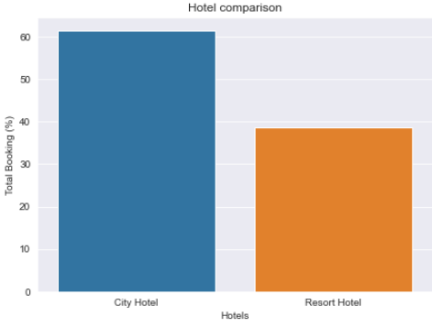
Which hotel gets booked more frequently?
More than 60% of the population booked the City Hotel

Slide 3
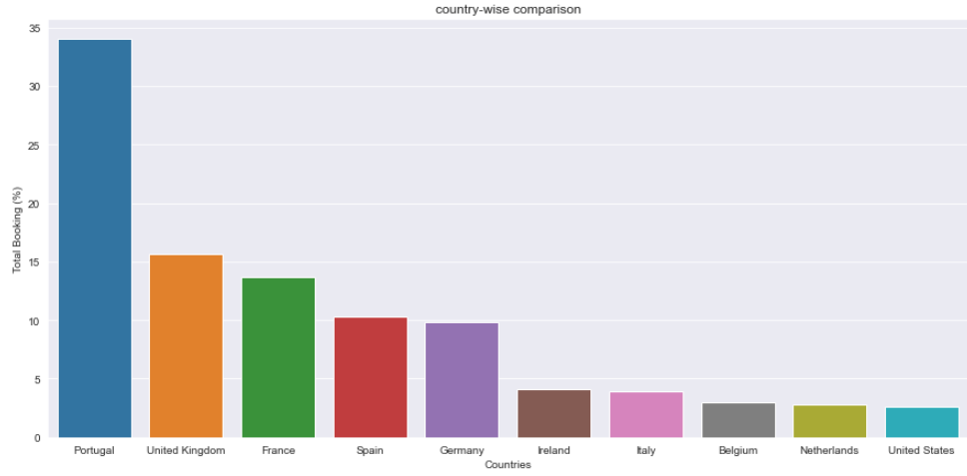
Which countries make the highest & lowest bookings?
Portugal, UK, France, Spain and Germany are the top countries from most guests come, more than 80% come from these 5 countries while least guests come from United States

Slide 4
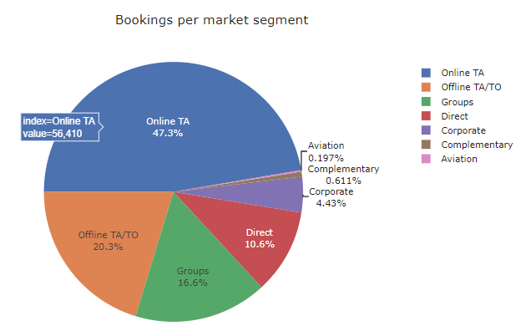
Which Market Segments make the highest & lowest bookings?
Majority of the bookings are made through Online TA (47.3%) while lowest share of bookings come from the Aviation segment

Slide 5
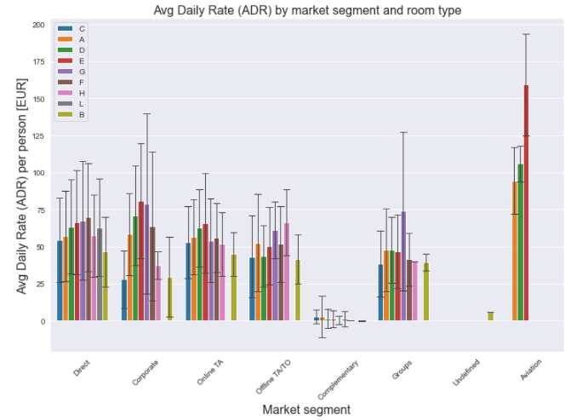
Which Market Segment pays the most for hotel bookings?
Aviation segment pays the highest price for booking rooms since their lead time is the shortest compared to other market segments

Slide 6
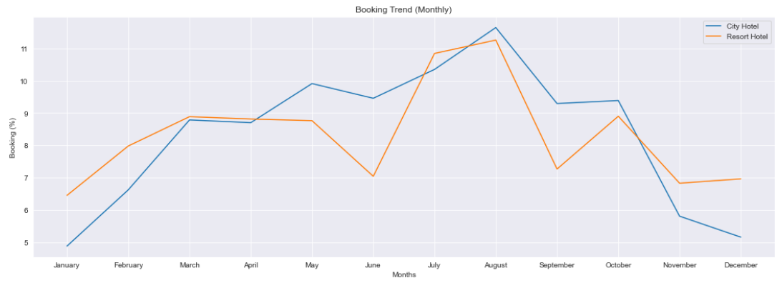
Which are the busiest & most idle months for the hotels?
Most bookings were made from July to August. The least bookings were made at the start and end of the year.

Slide 7
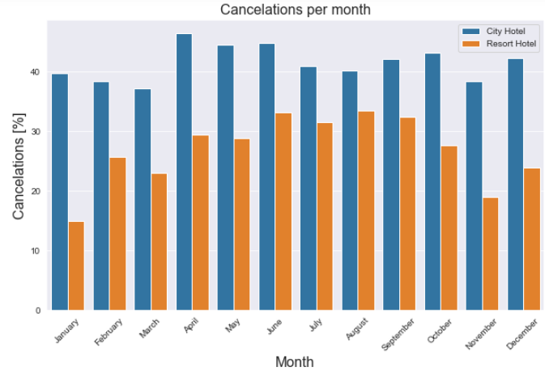
Which month has the highest number of cancelations?
For the City hotel the relative number of cancelations is around 40 % throughout the year and for the
Resort hotel it is highest in the summer and lowest during the winter.

Slide 8
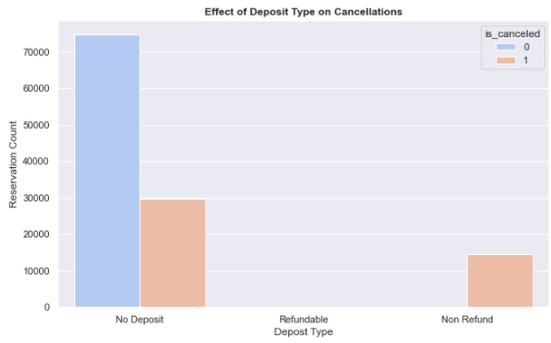
What is the Effect of Deposit Type on Cancellations?
Around 28% bookings were cancelled by guests with no deposit, followed by 22% bookings were cancelled which are with Refundable policy, So its obvious that guests who do not pay any deposit while booking are likely to cancel more reservations

Slide 9
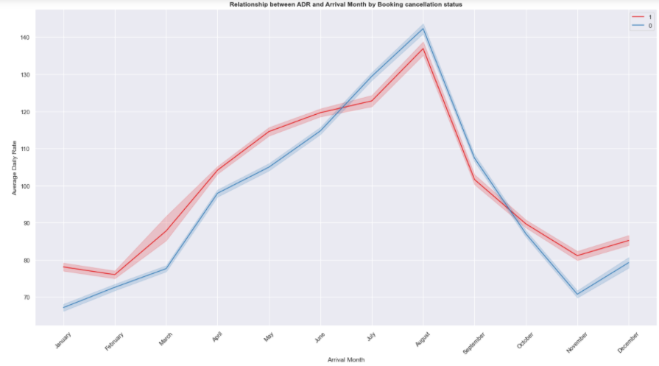
What is the relationship between Average Daily Rate(ADR) and Arrival Month by Booking cancellation status?
August has the highest ADR and it is the busiest month as well, which could be the reason behind increase in cancellations

Slide 10
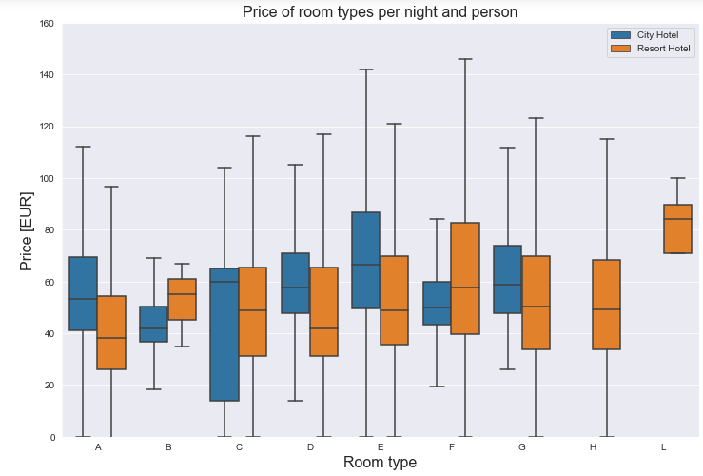
What is the avg price per room per night paid by hotels’ guests?
Avg. price per room per night for City Hotel = 48 €
Avg. price per room per night for Resort Hotel = 59 €

Slide 11
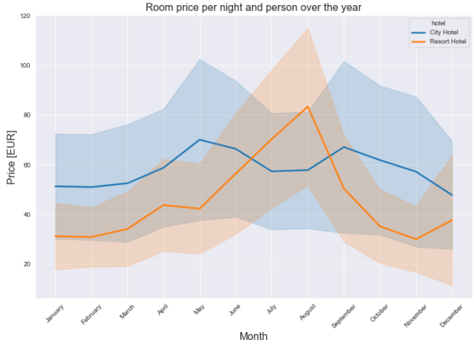
How does the price per night vary over the year for the hotels?
Prices in the Resort hotel are much higher during the summer while
The price of the city hotel varies less and is most expensive during spring and autumn seasons

Slide 12
Thank You

